Slide 1
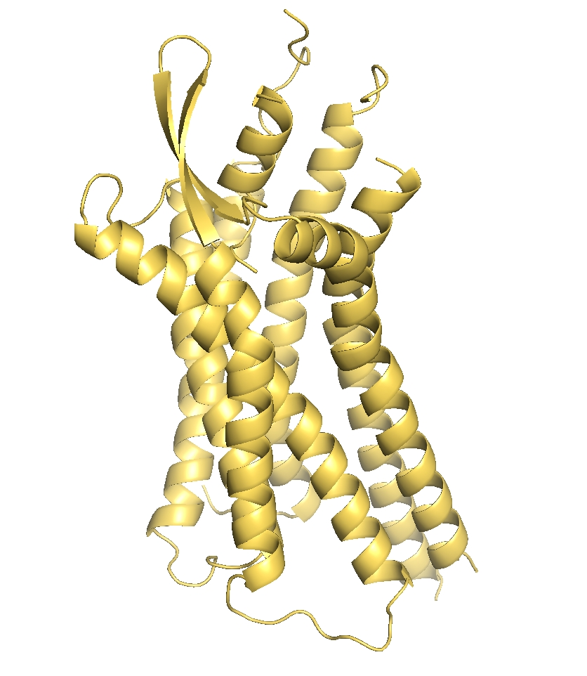






Learnable Gaussian Filters
Manifold Harmonic Message Passing
$$(N,n)$$
Concat
Feature Extraction
$$(N,n)$$
$$(N,2n)$$
$$F^{mp}=Φ$$
$$⊙Φ+F^{inp}$$
SASA/PDB
$$\left(N,N\right)→(N,k)$$
Ligand-Binding Pocket Classification
Eigenfunction Computation
Pre-computed
Task
Manifold Harmonic Message Passing

